Slide 1
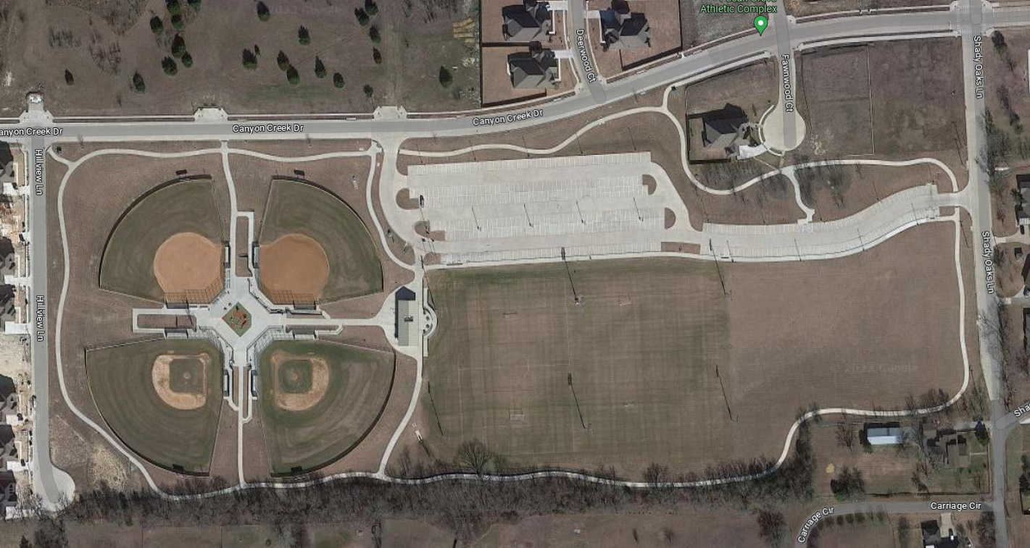
A
B
CLUB
Open practice area
C
D
E
F

